Slide 1
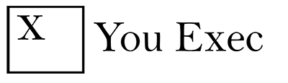
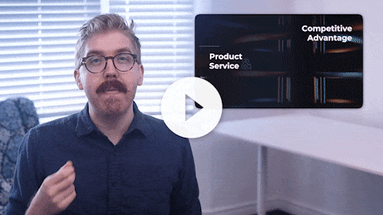
You Exec provides business resources that move your career forward. Access our full library of presentations, spreadsheet models, and business book summaries. We do the work, you take the credit.
Errors & Omissions Liability (E&O): You Exec makes no guarantee that the statements, analysis, projections, estimates, graphs, reports, numbers, and any derivatives sourced from this presentation are free of errors and omissions. You Exec assumes no liability for erroneous outcomes derived from this presentation.
Watch explainer
This video will walk you through the benefits of this framework. Paid members, please log in for a better viewing experience.
Found an error, have suggestions?
Feedback

Slide 2
You Exec
Corporate Resources

Slide 3

Mission Vision
&
We saw the current problem in the market and brought up a solution that can help resolving this problem. We believe that our product resolves our demographic’s biggest pain points and have strong and scalable growth potential.

Slide 4
Our Company
About Us
01
02
03
04
Product
Talent
Technology
Service
We offer a product that can allow our users to save money and earn passive income.
We offer a product that can allow our users to save money and earn passive income.
We offer a product that can allow our users to save money and earn passive income.
We offer a product that can allow our users to save money and earn passive income.

Slide 5
Our Company
Core Values
01
02
03
04
We offer a product that can allow our users to save money and earn passive income.
We offer a product that can allow our users to save money and earn passive income.
We offer a product that can allow our users to save money and earn passive income.
We offer a product that can allow our users to save money and earn passive income.

Slide 6

01
Our Solution
Our product features a pleasant user interface that allows a user to complete a task under a minute. Additionally, it provides multiple options for quick payment and transactions.

Slide 7

The World Awaits
Our product features a pleasant user interface that allows a user to complete a task under a minute. Additionally, it provides multiple options for quick payment and transactions. We provide users with ease of use, a clearly structured commission program, and the ability to generate passive income for a win-win situation.
CRISP & CLEAN

Slide 8

Value to Customers
Our product features a pleasant user interface that allows a user to complete a task under a minute. Additionally, it provides multiple options for quick payment and transactions. We provide users with ease of use, a clearly structured commission program, and the ability to generate passive income for a win-win situation.
CRISP & CLEAN

Slide 9

Product Service
Competitive Advantage
GROWTH & TRACTION
&
We have experienced a 60% growth in number of users in the past year. Of all users, 80% have performed at least one successful transaction, and of this 80%, over half are repeating users who have performed 5 or more transactions.

Slide 10

Main Focus
56%
Presentations
80%
Interviews
Our product features a pleasant user interface that allows a user to complete a booking under a minute. Additionally, it provides multiple options for quick payment and transactions.
70%
Insights
65%
Articles

Slide 11

02
Value Prop
Our digital platform provides a user-friendly solution to revolutionize peer-to-peer financial transactions. It is safe, hassle-free, and easy to set up regardless of users’ banking institution.

Slide 12

User Quote
I began using this service one month after it launched. I have made a lot from commissions and referrals. The app is also user-friendly and I have no trouble navigating its functions.

Slide 13




Meet Our Users
Joon
Jess
Joe
Jane
COMPANY ABC
XYZ CORP
STEALTH STARTUP
ABC LLC
The app is also user-friendly and I have no trouble navigating its functions.
The app is also user-friendly and I have no trouble navigating its functions.
The app is also user-friendly and I have no trouble navigating its functions.
The app is also user-friendly and I have no trouble navigating its functions.

Slide 14
Our Service
Project development
Strategy
2
Our product features a pleasant user interface that allows a user to complete a task under a minute.
Our product features a pleasant user interface that allows a user to complete a task under a minute.
1
Consulting
4
3
Research
Our product features a pleasant user interface that allows a user to complete a task under a minute.
Our product features a pleasant user interface that allows a user to complete a task under a minute.

Slide 15

03
Insights
We have a very simple transaction-driven business model. Its simplicity and scalability give us a great growth advantage.

Slide 16

Our product features a pleasant user interface that allows a user to complete a task under a minute. Additionally, it provides multiple options for quick payment and transactions. We provide users with ease of use, a clearly structured commission program, and the ability to generate passive income for a win-win situation.

Slide 17

Phases
Our product features a pleasant user interface that allows a user to complete a task under a minute. Additionally, it provides multiple options for quick payment and transactions. We provide users with ease of use, a clearly structured commission program, and the ability to generate passive income for a win-win situation.

Slide 18

Success Factor
THE WORLD CHANGES, WE'll BE THERE.
We saw the current problem in the market and brought up a solution that can help resolving this problem. We believe that our product resolves our demographic’s biggest pain points and have strong and scalable growth potential.

Slide 19

04
Our Company
We saw the current problem in the market and brought up a solution that can help resolving this problem. We believe that our product resolves our demographic’s biggest pain points and have strong and scalable growth potential.

Slide 20
Composition of Resources
30%
Marketing
45%
10%
This unique chart displays percentages by the size of the widget. The higher the percentage the larger each component of the chart will be.
PR
Facilities and equipment
15%
Hiring

Slide 21

REPORT 01
User Growth Divided by Month And Level
User Growth
CHART
Analysis:
We have a very simple transaction-driven business model. Its simplicity and scalability give us a great growth advantage.

Slide 22

REPORT 02
User Growth Divided by Month And Level
User Growth
CHART
Analysis:
We have a very simple transaction-driven business model. Its simplicity and scalability give us a great growth advantage.

Slide 23
REPORT 03
User Growth
CHART
Analysis:
We have a very simple transaction-driven business model. Its simplicity and scalability give us a great growth advantage.

Slide 24
REPORT 04
User Growth
CHART
Analysis:
We have a very simple transaction-driven business model. Its simplicity and scalability give us a great growth advantage.

Slide 25
FIRST CAMPAIGN
01
We have a very simple transaction-driven business model. Its simplicity and scalability give us a great growth advantage.
GROWTH
02
We have a very simple transaction-driven business model. Its simplicity and scalability give us a great growth advantage.
RECOGNITION
03
We have a very simple transaction-driven business model. Its simplicity and scalability give us a great growth advantage.

Slide 26
MORE GROWTH
04
We have a very simple transaction-driven business model. Its simplicity and scalability give us a great growth advantage.
VIRAL TESTS
05
We have a very simple transaction-driven business model. Its simplicity and scalability give us a great growth advantage.
COMMUNITY
06
We have a very simple transaction-driven business model. Its simplicity and scalability give us a great growth advantage.

Slide 27

Net Promoter Score
76
63
51
42
Q1
Q2
Q3
Q4
Today our customers love us. This is due to improvements in our customer support
Today our customers love us. This is due to improvements in our customer support
Today our customers love us. This is due to improvements in our customer support
Today our customers love us. This is due to improvements in our customer support

Slide 28

Dawn of a New Era
We saw the current problem in the market and brought up a solution that can help resolving this problem. We believe that our product resolves our demographic’s biggest pain points and have strong and scalable growth potential.

Slide 29
Dashboard
80%
23%
95%
62%
Results that matter
Innovative ideas are not just something new, they provide value and solve problems. It takes "buy-in" from an organization to support innovation. Understanding customer's needs are critical to design new products. Change requires analysis and testing just like any other experimental effort.

Slide 30

Milestones
1
Step One
We’re looking for $2M in funding, 40% of which will be spent on operations, 40% on human resources, and 20% on marketing. This will allow us to generate $6M in revenue in the next 12 months.
Step Two
2
We’re looking for $2M in funding, 40% of which will be spent on operations, 40% on human resources, and 20% on marketing. This will allow us to generate $6M in revenue in the next 12 months.
Step Three
3
We’re looking for $2M in funding, 40% of which will be spent on operations, 40% on human resources, and 20% on marketing. This will allow us to generate $6M in revenue in the next 12 months.

Slide 31

COMPETITORS
OUR COMPANY
Traditional methods of peer-to-peer financial transactions are often inconvenient, time-consuming, can potentially cost high transaction or service fees, and disrupts personal book-keeping workflows.
Our digital platform provides a user-friendly solution to revolutionize peer-to-peer financial transactions. It is safe, hassle-free, and easy to set up regardless of users’ banking institution.

Slide 32

Original Research
Succinct, yet powerful.
We saw the current problem in the market and brought up a solution that can help to resolve this problem. We believe that our product resolves our demographic’s biggest pain points and have strong scalability.
QUALITY VS. QUANTITY

Slide 33

Customer First
In 2018, we saw the current problem in the market and brought up a solution that can help to resolve this problem. We believe that our product resolves our demographic’s biggest pain points and have strong scalability.
TOGETHER WE DISCOVER

Slide 34
Portfolio
Product 1
Product 2
Product 3
Product 4
We have a diversified approach.
Our digital platform provides a user-friendly solution to revolutionize peer-to-peer financial transactions. It is safe, hassle-free, and easy to set up regardless of users’ banking institution.

Slide 35



Portfolio
Demonstrate our vision
Our digital platform provides a user-friendly solution to revolutionize peer-to-peer financial transactions. It is safe, hassle-free, and easy to set up regardless of users’ banking institution.

Slide 36

LET'S START
IN A WORLD OF QUANTITY, OUR COMPANY DELIVERS QUALITY
LET'S DESIGN THE WORLD WE WANT

Slide 37


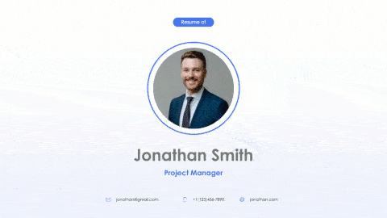
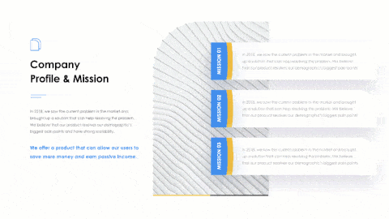
Related
The following resources are related to this framework and can save you hours of work.
If you’re a free or paid member, log into You Exec first for a better download experience.
Ultimate Pitch Deck
Sustainability Report
Personal Showcase
Client Pitch Deck

